Slide 1
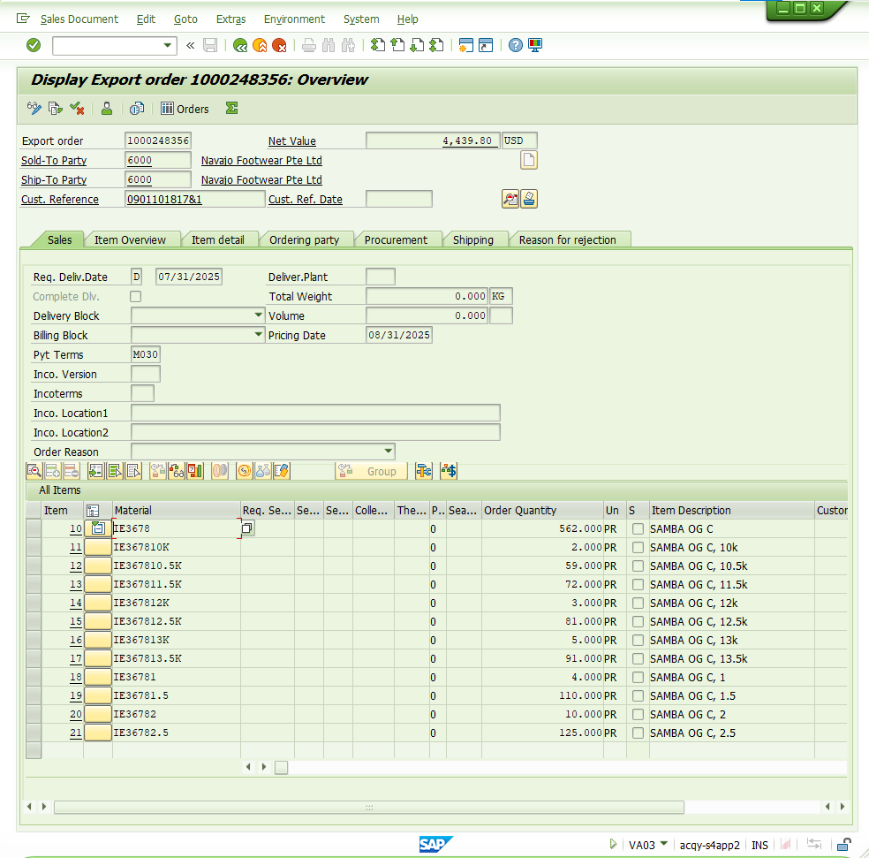
SO Details check va03

Slide 2
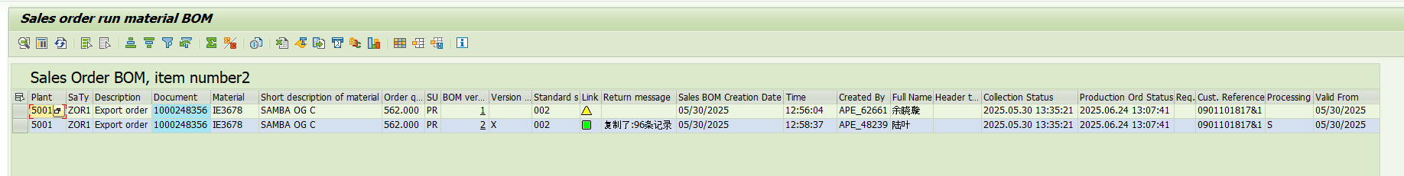
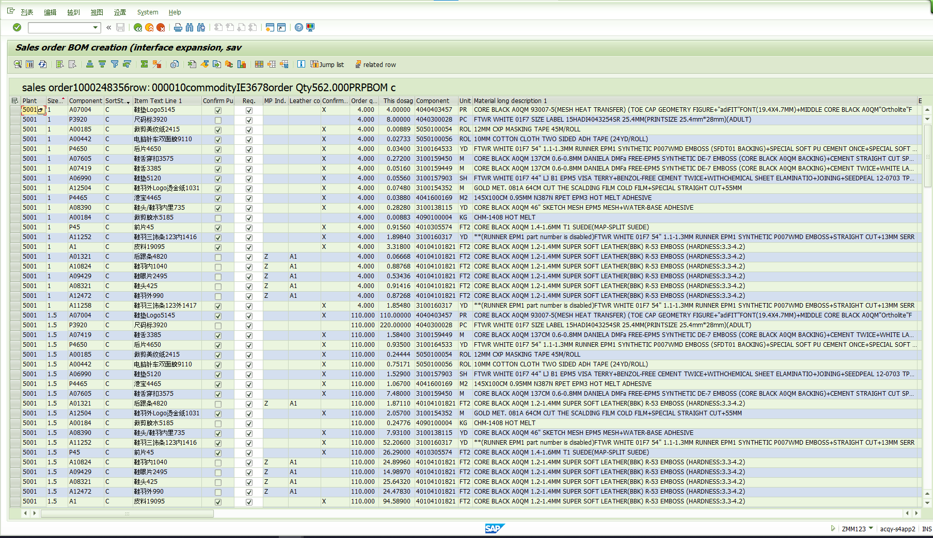
BOM data check ZMM123

Slide 3
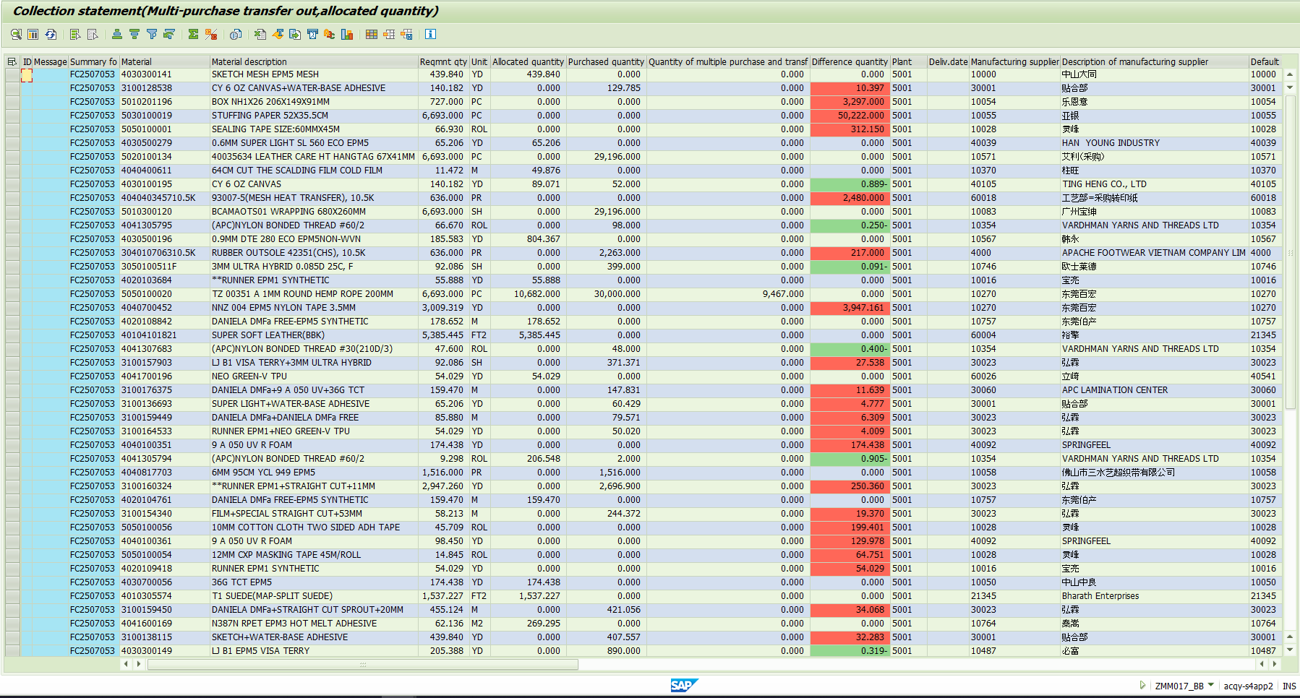
Purchase order enq. ZMM017_BB

Slide 4
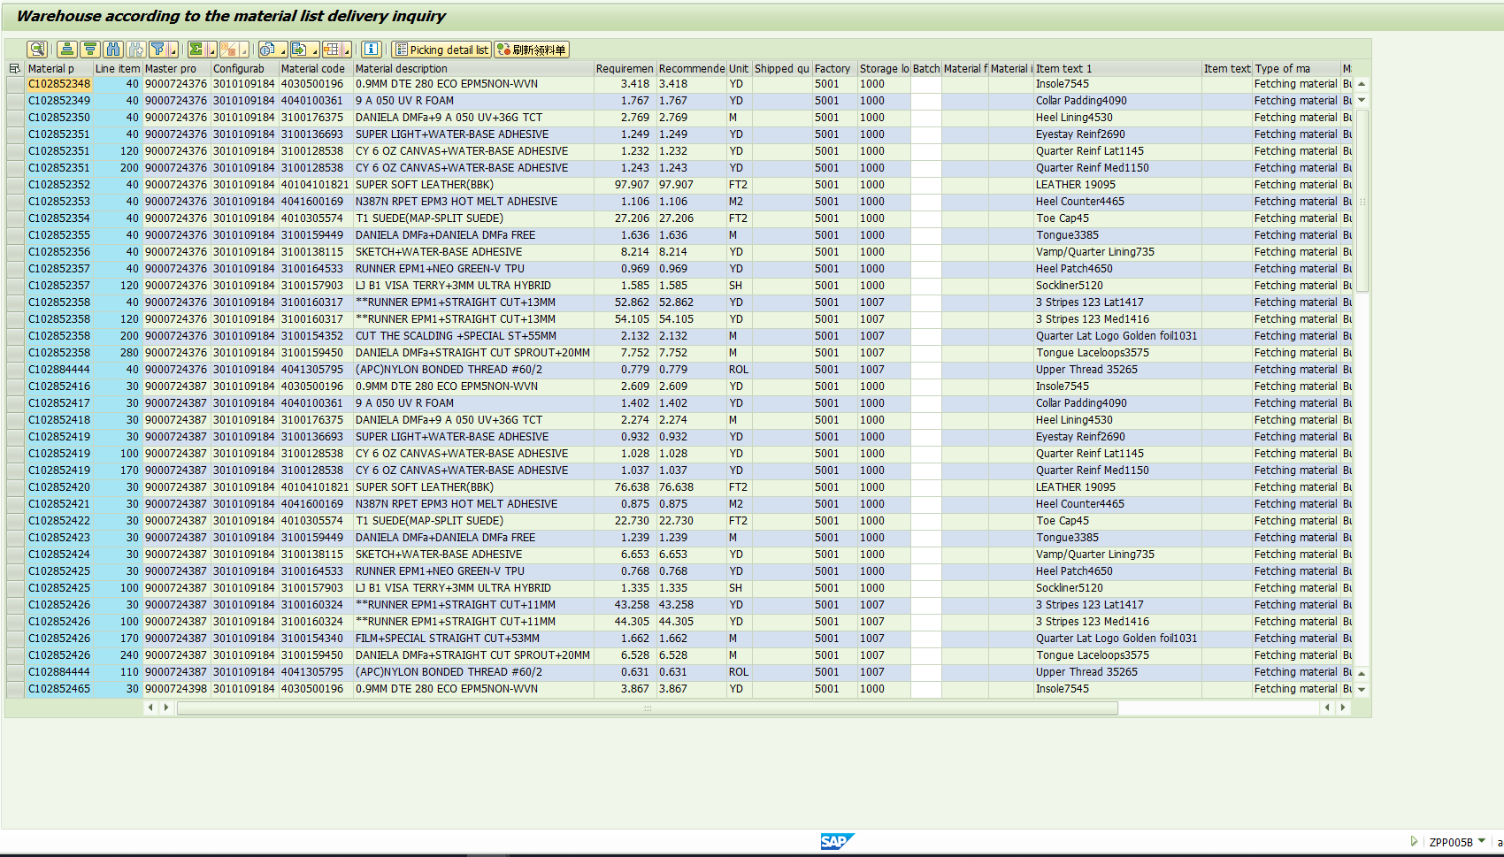
Pickings / materail list enquiry ZPP005B

Slide 5
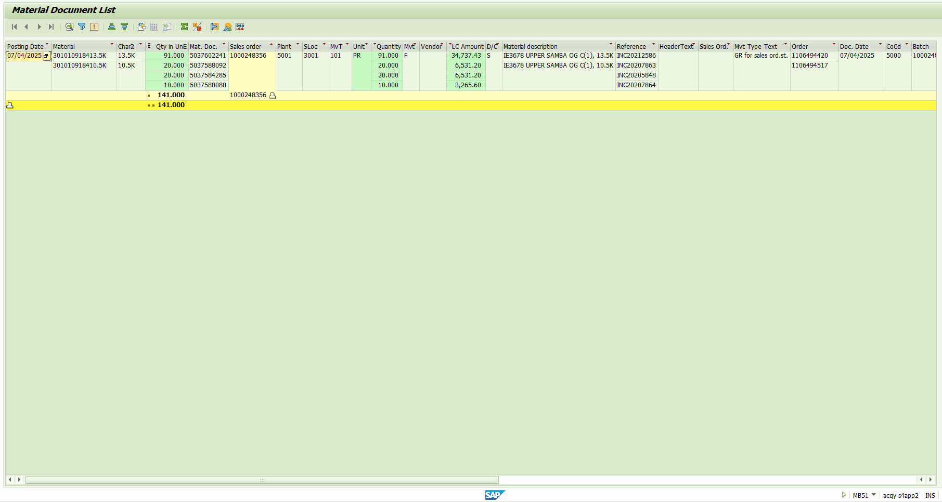
Warehouse stock check MB51
ZPP096A FOR CHECK PRODUCTION OUTPUTS

